Slide 1
Liquid PVA: Dual Supplier Discussion
Notes:
Update on the liquid PVA decision. Since last time, two things happened: PCI Manufacturing's experiment met our spec, and they gave us a real price. Today: the cost side by side, how we got here and what the experiment cost, what running two suppliers would look like, then three options - because we need to choose one before our next conversation with SNP.

Slide 2
How we got here — a series of events, and what the PCI experiment cost
2 · PCI
Nov 2025
Brenntag never meets viscosity
Mar–Apr 2026
~15–20 serious candidates screened
May 2026
ArroChem, ILC Dover fail the heat gate
26 Jun 2026
CJB Applied Technologies clears the gate
Jul 2026
Columbus Chemical Industries cannot hold temperature
4 Aug 2026
CJB priced out
Aug–Sep 2026
PCI Manufacturing lab batches
22 Sep 2026
PCI test results
28 Sep 2026
Spec met — real quote
Above range, unreadable on their viscometer. They stalled — no quote ever received. Mar 2026: a resin sample instead
ArroChem Inc., Piedmont Chemical Industries, ILC Dover approached. One gate: hold 90–95 °C
ArroChem: right kind of company, could not get past 90 °C. ILC Dover could not reach it either
Front-runner. APV Engineered Coatings confirms heat but calls $1.50/lb too cheap — likely ≥$3/lb, unconfirmed. Demand: ~3 drums/week
Right kind of company; reached out to us, then said they cannot hold 90–95 °C. Eliminated; never quoted
$8.00–8.50/lb toll excl. materials (~11× SNP). Their $6,400 trial declined — capability never corroborated
Two-plus batches, a dilution study, method work — unpaid
Viscosity brought on target within the test (solids / water adjustment). Spec agreed: 11% / 900–1,100 cP
$3.50/lb per 5-drum batch; $6.00 below a batch
~15–20
serious candidates screened
7
engaged in tests or calls
4
could not make it — heat or viscosity (Brenntag, ArroChem, ILC Dover, Columbus)
2
could, but priced out or never quoted (CJB $8.42; APV ≥$3, est.)
1
can make it: PCI Manufacturing, $3.50/lb
Capability is not common
• The 90–95 °C dissolution cook at 55-gallon scale eliminated most of the market. One shop passed in ten months; the rest failed on heat, on viscosity, or on price
Capability is expensive
• Everyone who can do it charges 4× to 11× SNP: PCI $3.50, APV ≥$3 (est.), CJB $8.42 — against $0.75. Small batches, drum freight and risk are priced in
SNP Inc. is an outlier, not a benchmark
• A specialist, close by, right-sized tanks, PVA as its core line, and a price below the whole US market. We cannot replicate that price; we can only protect it
Ten months, seven suppliers engaged, one shop that can make it — at 4.7× SNP's price. SNP Inc. is an outlier we cannot replicate, only protect.
Notes:
How we got here, as a series of events. November last year: Brenntag, a distributor, tried our formula - the viscosity came out above range, unreadable on their viscometer; they stalled and we never received a quote; in March they sent us a resin sample instead. March to April: we screened fifteen to twenty serious candidates and reached out to ArroChem, Piedmont and ILC Dover with one hard gate - hold 90 to 95 degrees. May: ArroChem - the right kind of company - could not get past 90 degrees, and ILC Dover could not reach it either. June 26: CJB cleared it and became the front-runner; APV confirmed heat but, on our call, called a dollar fifty a pound too cheap for our volume - so we estimate APV at three dollars or more, never confirmed; we confirmed demand at about three drums a week - 150 a year. July: Columbus Chemical, also the right kind of company, reached out to us and then told us directly they cannot hold the temperature - eliminated, never quoted. August 4: CJB's quote came in at 8 to 8.50 a pound for toll processing alone - eleven times SNP - and their trial would have cost 6,400 dollars; we declined, so we never corroborated whether they could actually make it. August to September: PCI Manufacturing ran two-plus lab batches and a dilution study, unpaid. September 22: PCI's test results - the viscosity was brought on target within the test by adjusting solids and water - and the spec was agreed. September 28: spec met, and a real quote of 3.50 a pound per five-drum batch. What it is worth: a cold start is now months, not a year. What it cost: PCI's unpaid engineering, and about 15 thousand of our own hours, sunk. Using it costs 62 thousand a year plus a permanent discipline; walking away costs goodwill; the middle is one or two batches a year.

Slide 3
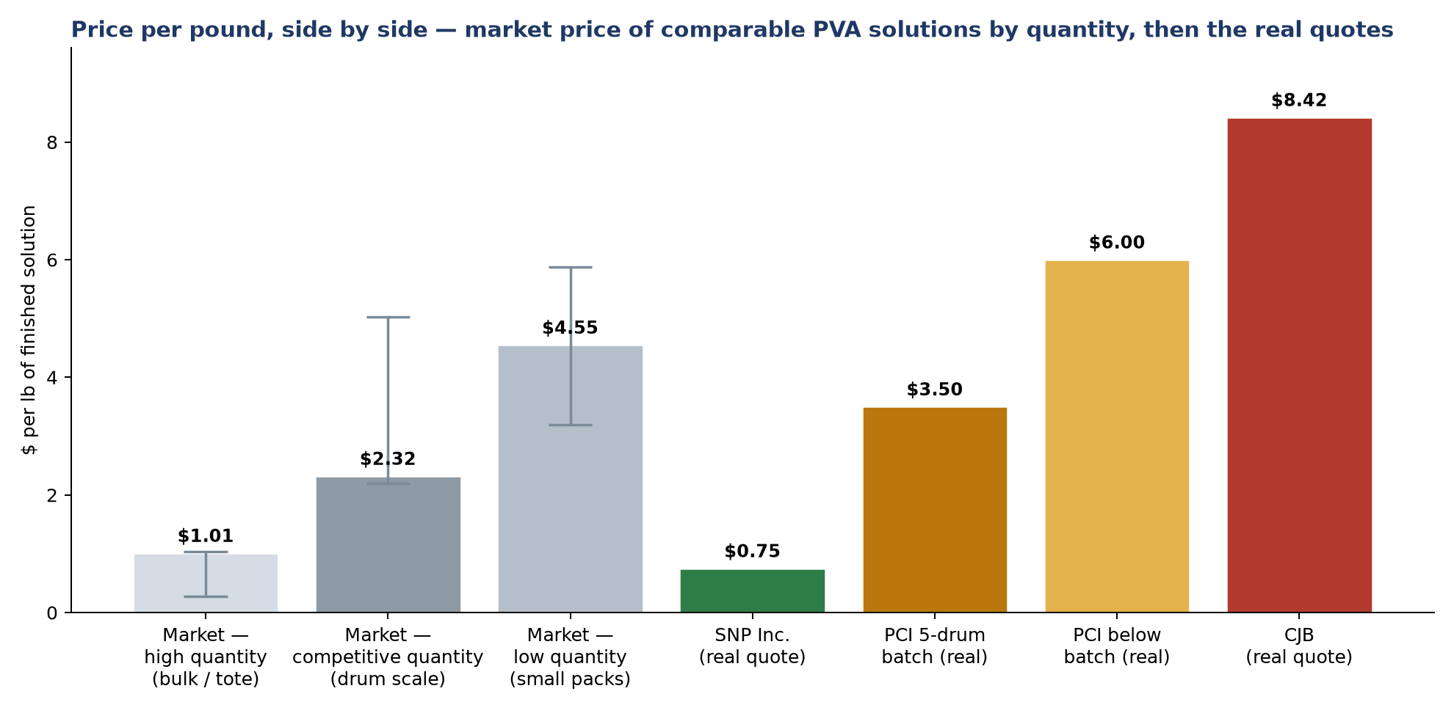
Price per pound, side by side — and where each number comes from
1 · COST
Where each number comes from
Market, competitive quantity $2.32 — comparable pre-mixed PVA solution at drum scale; range 2.20-5.03, n=7
Market, low quantity $4.55 — small packs; range 3.19-5.87, n=32
Market, high quantity $1.01 — totes / bulk; range 0.28-1.04, n=5
SNP Inc. $0.75 — real quote, delivered all-in — a specialist's price
PCI $3.50 / $6.00 — real quote, 28 Sept: one 5-drum batch / anything smaller
CJB $8.42 — real quote: $8.00–8.50 toll excluding materials, plus resin
Why a non-specialist sits far above the market: batch-fixed conversion cost over few pounds, drum-scale freight, risk priced in. SNP Inc.'s tanks are right-sized to our order and PVA is their core line.
At competitive quantity the market sells comparable PVA solution around $2.32/lb. SNP Inc. is below it; PCI is well above it; CJB is off the scale.
Notes:
Price per pound, side by side. Colors: greys are the market, green is SNP, the two ambers are PCI - dark for the batch price, light for below batch - and red is CJB. The three bars on the left are the market: what comparable pre-mixed PVA solution sells for today at high quantity - totes and bulk - at competitive quantity - drum scale, the one that matters - and at low quantity - small packs; ranges and counts are in the workbook's Market Study tab. Green is SNP's real quote at 75 cents, below the competitive market: a specialist's price. Navy and red are PCI's real numbers: 3.50 for a batch, 6 for anything smaller. Red on the far right is CJB, for scale. Why is a non-specialist so far above the market? Batch-fixed conversion cost spread over few pounds, drum-scale freight, and risk priced in. SNP's tanks are right-sized to our order and this is their core line.

Slide 4
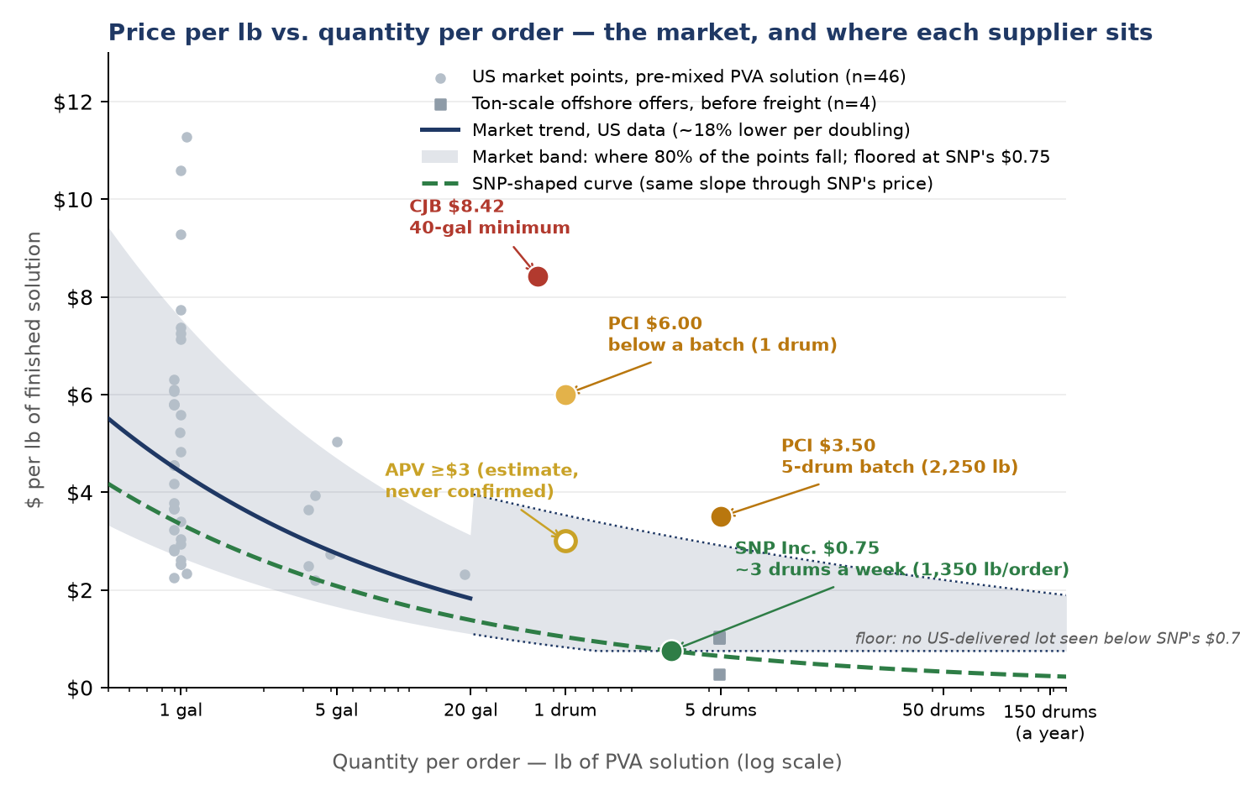
Price per lb of PVA vs. quantity per order — the curve, and where each supplier sits
1 · COST
Reading the chart
Left to right — quantity per order, 1-gallon jug to 150 drums, log scale
Grey points — verified prices of pre-mixed PVA solution by pack size: US composites grade up to 20 gal; ton-scale offshore offers before freight
Navy line and band — the trend: ~18% lower per doubling of the lot. The band is where 80% of the verified points fall around it; beyond 20 gal its top follows the flattening in vendors' ladders, and its floor is SNP's $0.75 — no US-delivered lot has been seen cheaper (offshore ton offers are before freight and duty). One drum $0.83–3.53; SNP's lot $0.75–3.09; a 5-drum batch $0.75–2.91
SNP Inc., green — $0.75 at ~3 drums a week — the floor of the band, and delivered, to our spec: the cheapest price in the market for a better product
Green dashed — the same slope through SNP's price: if we ever bought smaller lots from SNP, expect ~$1.04 at one drum, ~$2.08 at 5 gallons — a regression, not a quote
PCI, ambers — $3.50 at a 5-drum batch, $6.00 below it — above the band: batch-fixed cost and drum freight priced in
CJB, red · APV, hollow — CJB $8.42 at a 40-gal minimum sits far above the band; APV ≥$3 (estimate from our call, never confirmed) sits at the band's top
Price follows lot size across this market. SNP Inc. is its floor — drum lots at $0.75, delivered to our spec; every other supplier that can make it charges the top of the band, or more.
Notes:
Price per pound against quantity per order. The grey points are the verified market prices of pre-mixed PVA solution at every pack size we found - one-gallon jugs, cases, pails, a twenty-gallon lot, and ton-scale offers offshore before freight. The navy line is the curve fitted through them: price falls about eighteen percent every time the lot doubles where we have US data, up to twenty gallons. The band is where eighty percent of the verified points fall around that trend; beyond twenty gallons, where no US vendor publishes a price, its top follows the flattening seen in vendors' own volume ladders, and its floor is SNP's 75 cents - no US-delivered lot has been seen cheaper; the offshore ton offers are before freight and duty. SNP, green, sells us about three drums a week at 75 cents - the floor of that band, and delivered, to our spec, even though the market points are neither delivered nor medical-grade. The green dashed line is the same slope drawn through SNP's price: it is what to expect if we ever bought smaller lots from them - about a dollar at one drum, about two dollars at five gallons. It is a regression from the market's behaviour, not a quote from SNP. PCI, in amber, sits above the top of the band at its quantities - the batch-fixed cost and drum freight of a non-specialist. CJB is off the curve entirely; APV's three dollars is an estimate from our call, never confirmed. The message: price follows lot size everywhere in this market, except at SNP.

Slide 5
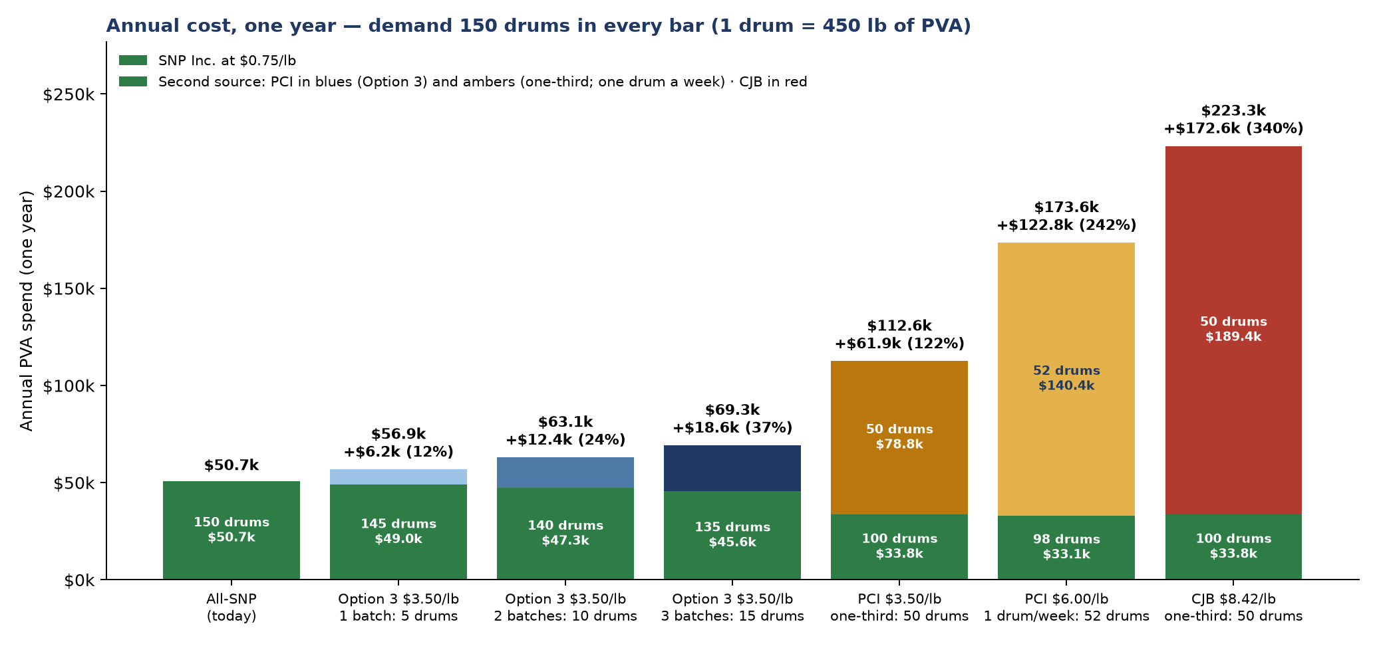
Annual cost, side by side — what each option adds to today's $50.7k
1 · COST
Reading the chart (one year)
Demand — 150 drums a year in every bar (1 drum = 450 lb of PVA); SNP Inc. at $0.75/lb keeps whatever the second source does not take
All-SNP — 150 drums × $337.50 = $50.7k
Option 3, blues — 1 / 2 / 3 batches of 5 drums a year (3% / 7% / 10% of demand) at $3.50/lb: +$6.2k / +$12.4k / +$18.6k
PCI $3.50 — one-third = 50 drums (10 batches, 33%) at $3.50/lb = $78.8k → $112.6k; +$61.9k (122%)
PCI $6.00 — one drum a week = 52 drums (35%, almost one-third), ordered below batch size → $173.6k; +$122.9k (242%)
CJB $8.42 — one-third = 50 drums, for scale → $223.3k; +$172.6k (340%)
Why the bars differ — only the second source's quantity and price change
Not in the chart — internal hours and one-time costs — the options slide
Option 3 adds $6–19k a year. A one-third second source at PCI's $3.50 more than doubles the bill (2.2×); one drum a week at $6.00 costs more still.
Notes:
Annual cost side by side. The same 150 drums a year in every bar - a drum is 450 pounds of PVA; SNP at 75 cents a pound keeps whatever the second source does not take. Green alone is today: 50.7 thousand. The three blues are Option 3: one, two or three five-drum batches a year at 3.50 - plus 6, 12 or 19 thousand. Dark amber is a one-third second source at PCI's batch price: 50 drums, ten batches, 112.6 thousand total, plus 61.9 - 122 percent of today's bill. Light amber is one drum a week at the 6-dollar below-batch price: 52 drums, 35 percent, almost a third - 173.6 thousand, plus 122.9; the small-order version is the expensive one. Red is CJB at one third, for scale: 223 thousand. Internal hours and one-time costs are on the options slide.

Slide 6
Three options — what each costs, how the year runs, what each supplier sees
3 · OPTIONS
The year, week by week — green: SNP Inc. material · colored blocks: PCI batches (5 drums = ~12 days)
Option 1
Second supplier at one-third
10 PCI batches a year: ~12 days on PCI material every ~5 weeks
Drums a year 150 = SNP 100 + PCI 50 (33%)
Money a year $112.6k = SNP $33.8k + PCI $78.8k
SNP Inc. sees 10 pauses of ~12 days, or level with a rolling stock
If SNP fails, restart in weeks, if PCI's ramp is confirmed in writing
Option 3
Keep-alive: 1–3 batches a year
one ~12-day block per batch, when we choose
Drums a year 150 = SNP 145 / 140 / 135 + PCI 5 / 10 / 15
Money a year $56.9k / $63.1k / $69.3k (PCI $7.9k / $15.8k / $23.6k)
SNP Inc. sees 1–3 pre-announced pauses, or none
If SNP fails, restart in weeks to a few months
Option 2
Strengthen SNP Inc. only
all year on SNP Inc.; PCI kept as a quoted option
Drums a year 150 = SNP 150
Money a year $50.7k = SNP $50.7k — what we pay today
SNP Inc. sees a strengthened partner
If SNP fails, restart in ~3–6 months; decays after ~12 months idle
Jan
Apr
Jul
Oct
Dec
Demand: 150 drums a year (1 drum = 450 lb of PVA), ~3 a week. A 5-drum PCI batch is used in one ~12-day block (drums land ~4 days old, expire on day 18). Purchases at today's volume: SNP $337.50 a drum, PCI $1,575 a drum; all grow ~10%/yr. Internal hours to finish PCI's qualification (~$15–40k once) are not included.
Option 3 keeps a paid, practiced supplier for $6–19k a year on top of today's $50.7k, with one to three pre-announced pauses for SNP Inc. — Option 1 more than doubles the bill and changes SNP's year.
Notes:
Three options on one page: what each costs, how the year runs, what each supplier sees. The strips are the year, week by week: green is SNP material, colored blocks are PCI batches - each five-drum batch is about twelve days at full rate, because the drums land about four days old and the eighteen-day life is counted from manufacture, so a batch is used in one block. Option 1: ten blocks a year, one every five weeks - SNP sees ten pauses, or a level cadence if we carry about three drums of rolling stock; PVA purchases of 112.6 thousand a year, growing with volume; recovery in weeks only if PCI confirms the ramp in writing. Option 3: one or two blocks a year, when we choose - 56.9 thousand with one batch, 63.1 with two, 69.3 with three - SNP keeps 145, 140 or 135 drums; SNP sees one or two pre-announced pauses or none; restart in weeks to a few months. Option 2: the whole year on SNP, PCI a quoted option - 50.7 thousand, what we pay today; if SNP fails, three to six months, and a cold start decays after a year idle. Why not run PCI alongside SNP at a third of rate instead of blocks? A batch would last thirty-six days - twice the life; even at two-thirds it takes eighteen. A validated twenty-one-day life gives margin; a thirty-day life still needs PCI at about half of rate. For us, two suppliers means one spec and one viscometer method, freeze-protected freight, a written failover with SNP's lead time, PCI's residual-film issue closed before any production batch, and two quality agreements. Purchases only: internal hours to finish PCI's qualification - fifteen to forty thousand once, under Options 1 and 3 - are not in these numbers.

Slide 7
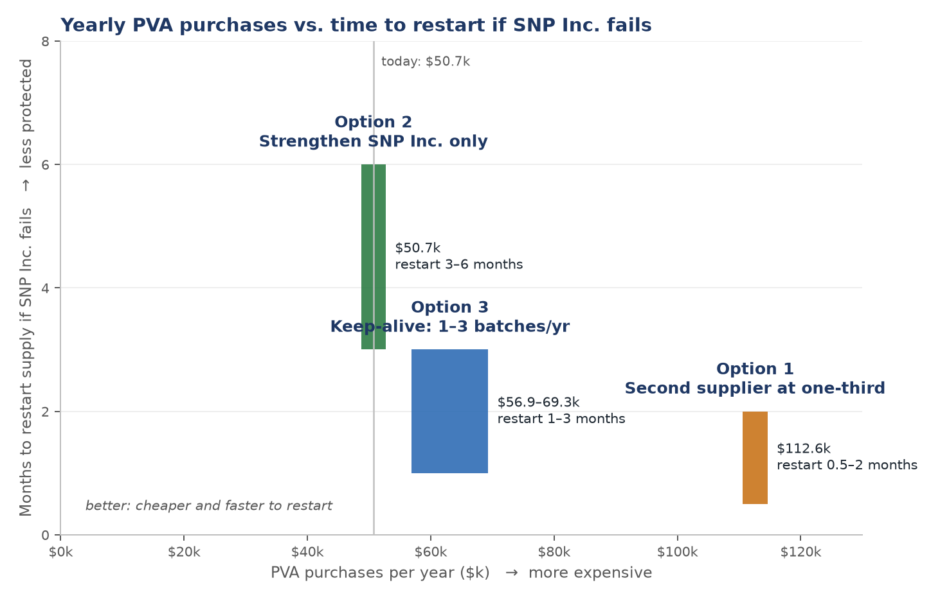
Cost against protection — where each option sits
3 · OPTIONS
Reading the chart
Left to right — PVA purchases in a year: SNP Inc. at $0.75/lb plus PCI at $3.50/lb. Today is $50.7k (grey line). Internal hours to finish PCI's qualification are not included
Bottom to top — how long we would be without PVA if SNP Inc. stopped tomorrow — the time to restart supply elsewhere
Each box — the range of one option on both measures; a box lower and further left is better
Option 2, green — $50.7k, what we pay today; least protected — a cold start of ~3–6 months, longer as the file goes stale
Option 3, blue — $56.9–69.3k (1–3 batches); a practiced supplier restarts in weeks to a few months — $43–56k a year less than Option 1
Option 1, amber — $112.6k; most protected — weeks, if PCI's ramp is confirmed in writing — and the same every year, growing with volume
Not shown — what SNP Inc. experiences: 10 pauses a year under Option 1, 1–3 under Option 3, none under Option 2
Option 3 buys most of Option 1's protection for ~$50k a year less. Option 1 pays every year for weeks of extra speed — worth it only if the outage would cost far more.
Notes:
Cost against protection. Left to right is what each option means in PVA purchases for a year - SNP at 75 cents plus PCI at 3.50; today's 50.7 thousand is the grey line; bottom to top is how long we would be without PVA if SNP stopped tomorrow. Each box is the range of one option. Green, Option 2, 50.7 thousand, is the cheapest and the least protected: a cold start of three to six months, and longer as the file goes stale. Blue, Option 3, 57 to 69 thousand for one to three batches, sits in the middle: a practiced supplier restarts in weeks to a few months, about fifty thousand a year less than Option 1. Amber, Option 1, 112.6 thousand, is the most protected - weeks, if PCI confirms the ramp in writing - and the most expensive, every year. The chart does not show what SNP experiences: ten pauses a year under Option 1, one or two under Option 3, none under Option 2. The question for Finance is whether the extra weeks of speed under Option 1 are worth about 62 thousand a year.

Slide 8
Keeping a qualified supplier you barely use — three instruments, weighted
4 · STRATEGY
A supplier stays ready without steady volume if it gets a real order now and then, signed terms, and payment for its work. Routine in medical devices, pharma and aerospace; what spoils the relationship is not the 'no' — it is silence and unpaid work.
1
ESSENTIAL — this is Option 3
2
ESSENTIAL — costs almost nothing
3
ONLY UNDER OPTION 2
Place a real order
Sign terms with no volume commitment
Pay for the work already done
One 5-drum batch, repeated 1–3 times a year. The only instrument that pays PCI with revenue and proves production scale; without it the other two are paperwork.
$3.50/lb, spec, lead time, quality and change-notification terms, valid 12–24 months, zero minimum. Locks the economic core of Option 3 in writing: the batch price with no volume string.
A development fee for the lab batches, studies and paperwork PCI did for free. Repairs the goodwill if we place no order. Under Option 3 the first batch is the payment, so this drops away.
Our cost: Legal time
PCI gets: 'Approved second source' status they can show
Our cost: $7.9k per batch
PCI gets: A customer, not an experiment
Our cost: ~$5–10k once, if at all
PCI gets: Paid for its effort
Conduct that keeps it intact
• Tell PCI the volume reality and the exact triggers · pay promptly · share the test results · a quarterly touchpoint. Suppliers allocate goodwill on trust and growth prospects, not on current volume (Pulles, Schiele et al. 2016).
Order a batch or two a year and put the terms in writing — that is what keeps the door open. A fee for the work done is the fallback if we order nothing.
Notes:
How companies keep a qualified supplier they barely use - because you will be asked whether Option 3 is realistic. It is routine in medical devices, pharma and aerospace. What spoils the relationship is silence and unpaid work, not the 'no'. Three instruments, weighted. First and essential: place a real order - one five-drum batch, one to three times a year; it is the only thing that pays PCI with revenue and proves production scale, and it is Option 3. Second and essential: sign terms with no volume commitment - the 3.50 batch price, spec, lead time, change notification, twelve to twenty-four months, zero minimum; it locks the economic core of Option 3 in writing and costs only legal time. Third, only under Option 2: pay a development fee for the work already done, to repair the goodwill if we order nothing; under Option 3 the first batch is the payment. Capacity-reservation fees and formal re-approval programs are pharma-scale practices that do not apply to us. And the conduct: tell PCI the triggers, pay promptly, share results, keep a quarterly touchpoint. The research is clear that suppliers allocate goodwill on trust and growth prospects, not current volume.

Slide 9
The SNP Inc. conversation — outline, and what we decide before it
5 · TIMING
The meeting, in order — what we say, and what we want out of each part
Decide before we walk in
The strategy — Option 1, 2 or 3 — sets the whole posture. Under Option 3 we say a continuity verification lot runs once a year; the supplier is not named. (Leadership)
How much forecast, what commitment — 12-month rolling and a 3-year outlook; whether a multi-year commitment or letter of intent is on the table. (Leadership, Legal)
The give — blanket order — yes or no; payment terms as a lever — yes or no. (Finance, Supply Chain)
The other hydrogels — which projects could use alginate or guar, at what solids. (R&D, before the meeting)
Continuity money — fund the resin buffer (~$2–6k tied up) and the shelf-life study — or not. (Supply Chain)
1 Why we are here Years of growth, How could we grow the relationship? Projects, partnership. → They hear investment, not audit
2 Our business, shown Volume history, the forecast (150 drums this year, +10%/yr), our delivery record, what the product does for our mission. → A growing account worth planning for
3 What we bring Rolling 12-month forecast refreshed monthly; a level weekly cadence through a blanket order; the hydrogel program as a written joint roadmap. → Predictability for their kettle and resin buys
4 Growing together Their other hydrogel lines — sodium alginate, guar gum — for our other projects. → A second and third line, if R&D has a use
5 Running it as partners Resin supply and a consignment buffer; capacity for Year-5 volume; cover for the people who run the PVA cook; advance notice of changes; a shelf-life study together. → Continuity agreed as a shared discipline, not a demand
6 Price A resin-indexed formula in place of ad hoc increases. → Predictability for both sides
7 Close Quarterly business review, named contacts, an updated Supplier Quality Agreement (SQA). → A cadence that keeps it alive
Decide the strategy and the give before the meeting; the meeting is where we execute the partnership, not where we discover it.
Notes:
The SNP conversation, in order. One: why we are here - growth, a sole source we depend on, and the intent to run it as a partnership; they should hear investment, not audit. Two: our business, shown - volume history, the forecast of 150 drums this year growing ten percent a year, our delivery record, what the product does for our mission. Three: what we bring - a rolling twelve-month forecast refreshed monthly, a level weekly cadence through a blanket order, and the hydrogel program as a written joint roadmap. Four: growing together - their other hydrogel lines, sodium alginate and guar gum, for our other projects, if R&D has a use. Five: running it as partners - resin supply and a consignment buffer, capacity for year-five volume, cover for the people who run the PVA cook, advance notice of changes, a shelf-life study together; continuity agreed as a shared discipline. Six: a resin-indexed price formula instead of ad hoc increases. Seven: close with a quarterly business review, named contacts and an updated quality agreement. Before we walk in we decide five things: the strategy, which sets the posture - under Option 3 we say a continuity verification lot runs once a year and we do not name the supplier; how much forecast we share and whether a multi-year commitment is on the table; the give - blanket order and payment terms; which projects could use the other hydrogels; and whether we fund the resin buffer and the shelf-life study.

Slide 10
Appendix: assumptions, suppliers, acronyms, frameworks
Assumption | Value | Basis
Demand today | 150 drums/yr (1 drum = 450 lb) = 1,300 lb/wk = 67,600 lb/yr; +10%/yr | Confirmed 2026-06-26; growth assumption
SNP Inc. price | $0.75/lb delivered = $337.50/drum | SNP Estimate 012726-1
PCI price | $3.50/lb per 5-drum batch; $6.00/lb below a batch | Quote 2026-09-28 — confirm terms in writing
Option 1 share | 1/3 = 50 drums/yr = 10 batches (22,500 lb) | Every chart bar; five-year uses an exact third
Option 3 keep-alive | 1–3 batches/yr = 5–15 drums = 3–10% of demand; +$6.2–18.6k/yr | $7.9k per batch ($3.50/lb × 2,250 lb); no volume term on the price so far
Market reference | $1.01 / $2.32 / $4.55 per lb | Market study: high / competitive / low quantity
CJB quote | $8.00–8.50/lb toll excl. materials ≈ $8.42 landed | $6,400 trial declined; email 'RE: mix test'
APV estimate | ≥ $3.00/lb — never confirmed | Called $1.50/lb too cheap for our volume on our call
Qualification cost | ~$15k of internal hours to date (sunk); ~$15–40k more to production release | Placeholders; not in the purchase totals
Restart time if SNP fails | Option 1 weeks (if ramp confirmed); Option 3 weeks to months; Option 2 ~3–6 months | Estimates; a cold start decays after ~12 months idle
Suppliers named
SNP Inc. — Durham, NC — incumbent, sole source
PCI Manufacturing — St. Louis, MO — CMS Manufacturing group; qualified-capable, quoted
CJB Applied Technologies — Valdosta, GA — quoted ~11×; $6,400 trial declined; eliminated 4 Aug 2026
ArroChem Inc. — Mount Holly, NC — right kind of company; could not get past 90 °C
ILC Dover — Frederica, DE — could not hold temperature
Columbus Chemical Industries — Columbus, WI — right kind of company; could not hold 90–95 °C; never quoted
Brenntag — distributor — trial blends never met viscosity (Nov 2025); stalled, no quote
Piedmont Chemical Industries — High Point, NC — reserve
APV Engineered Coatings — Akron, OH — heat confirmed; called $1.50/lb too cheap, likely ≥$3/lb (unconfirmed)
Acronyms
PVA — polyvinyl alcohol
cP — centipoise — viscosity unit
SQA — Supplier Quality Agreement
NDA — non-disclosure agreement
CPO — Chief Procurement Officer (Deloitte survey)
HBR / MIT SMR — Harvard Business Review / MIT Sloan Management Review
Frameworks (independently fact-checked)
Kraljic (HBR 1983), bottleneck items: 'Volume insurance (at cost premium if necessary). Control of vendors. Security of inventories. Backup plans.' Gelderman & van Weele (2003): 'hold' vs 'move'. Simchi-Levi et al. (Interfaces 2015): disruption impact is uncorrelated with spend. Sheffi & Rice (MIT SMR 2005): single sourcing is legitimate only with a deep, managed relationship. Tomlin (2006); Chopra & Sodhi (2014): assuming zero disruption probability is the expensive mistake. Pulles, Schiele et al. (2016): preferential treatment follows attractiveness, not volume. Deloitte Chief Procurement Officer (CPO) Survey 2025: 'active alternative sources' rated most effective (74%). No standard or regulation we work under requires a second source; controls are proportionate to risk. Six lenses; four refuted claims excluded; memo in the repo.
Workbook: PVA_Second_Supplier_Leadership_Model.xlsx — 'Summary' holds every slide figure as a formula; 'Supplier Quotes', 'Market Study', 'PCI Quote Scenarios', 'PCI Experiment' hold the compiled data.
Notes:
Assumptions, suppliers by full name, acronyms, and the fact-checked frameworks. The workbook's Summary tab holds every slide figure as a formula; Supplier Quotes, Market Study, PCI Quote Scenarios and the PCI Experiment record hold the compiled data.

